Slide 1

FRENCH BAKERY
ANALYSIS
PRESENTED BY AMISH ILYAS

Slide 2

PROJECT OVERVIEW
PROBLEM STATEMENT
STEPS AND TOOLS
ANALYSIS
INSIGHTS

Slide 3
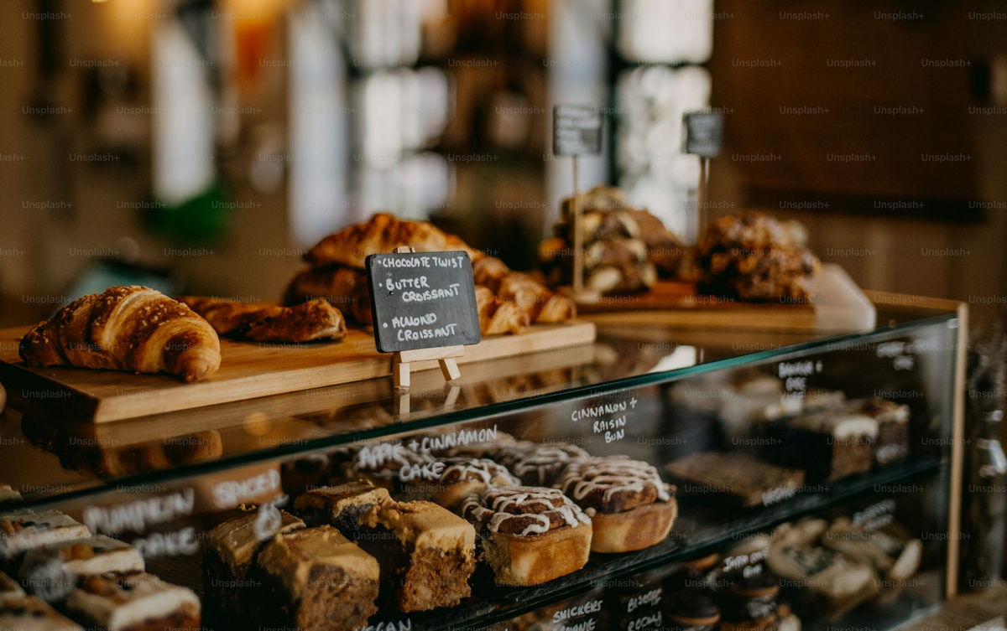
PROBLEM STATEMENT
OPTIMIZING SALES & INVENTORY MANAGEMENT FOR A FRENCH BAKERY
The bakery is experiencing inconsistent sales patterns, leading to potential issues like overstocking, understocking, and missed revenue opportunities. Additionally, the business is unsure about the best-selling products, peak sales hours, and customer purchasing behavior, making it difficult to optimize pricing, staffing, and promotions.

Slide 4
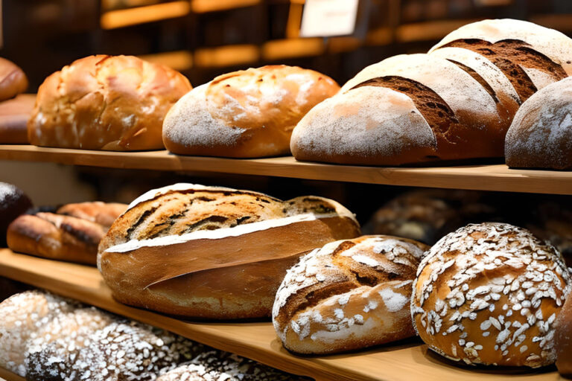
DATASET OVERVIEW
COLUMNS PRESENT IN DATASET :
DATE
TIME
TICKET_NUMBER
ARTICLE
QUANTITY
UNIT_PRICE

Slide 5

STEPS AND TOOLS
STEP 1 : IMPORTED DATA AS A DATAFRAME IN PANDAS
Vision
Mission
STEP 2 : PERFORMED EDA TO UNDERSTAND DATA
STEP 3 : DATA CLEANING
STEP 4 : FEATURE ENGINNERING
STEP 5 : ANALYSIS
THIS PROJECT IS CREATED USING PURE PYTHON AS DATA CONSISTS OF 200K PLUS RECORDS MAKING IT DIFFICULT TO ANALYZE IN EXCEL DUE TO PERFORMANCE ISSUE

Slide 6
Analysis
KPI’S
1 Total Orders : 219756
2
2 AVG Order Quantity : 1.349
3 Total Revenue : 478662.69
4 Average Ticket Size : 478662.69

Slide 7
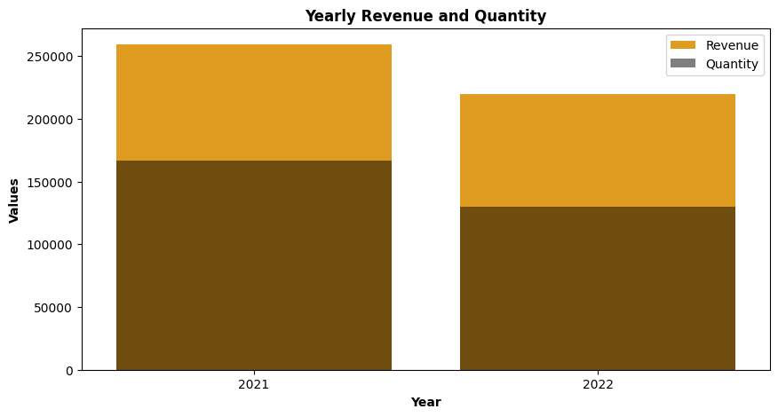
YEARLY REVENUE AND QUANTITY
1 2021 HAD HIGHER REVENUE COMPARED TO 2022.
2 QUANTITY SOLD ALSO DECREASED IN 2022, THOUGH NOT AS SIGNIFICANTLY AS REVENUE.
3 THE GAP BETWEEN REVENUE AND QUANTITY IS LARGER IN 2021, INDICATING THAT EITHER HIGHER-PRICED PRODUCTS WERE SOLD OR PRICES WERE INCREASED IN THAT YEAR.

Slide 8
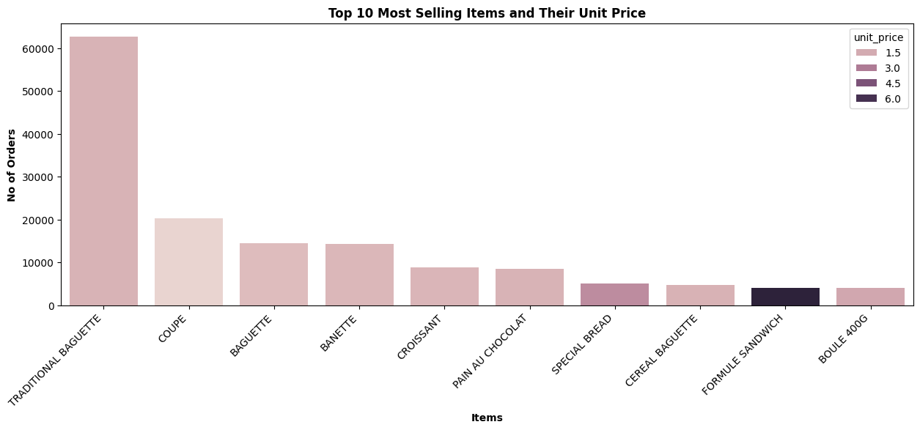
TOP 10 MOST SELLING ITEMS
1 TRADITIONAL BAGUETTE DOMINATES SALES SIGNIFICIANTLY , OUTSPANCING OTHER ITEMS
2 OTHER POPULAR ITEMS INCLUDE COUPE, BAGUETTE, BANETTE, AND CROISSANT —INDICATING STRONG CUSTOMER DEMAND FOR BAKERY STAPLES.
3 THE UNIT PRICE IS SHADED, WITH DARKER SHADES REPRESENTING HIGHER PRICES.
4 MOST OF THESE TOP-SELLING ITEMS SEEM TO HAVE RELATIVELY LOWER UNIT PRICES, WHICH COULD CONTRIBUTE TO THEIR HIGH SALES VOLUME.

Slide 9
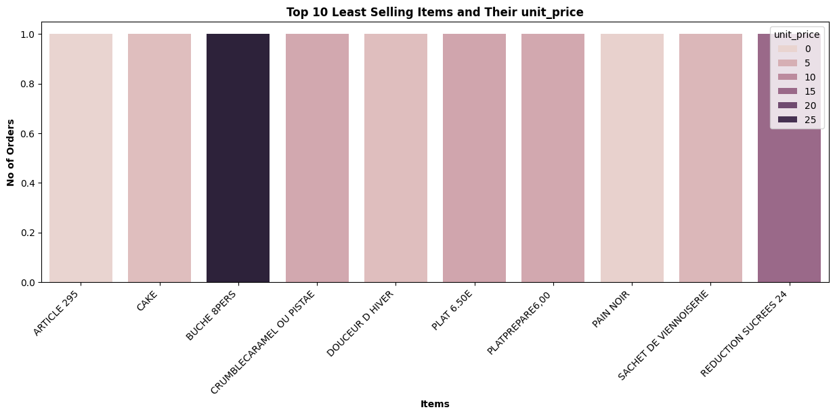
TOP 10 LEAST SELLING ITEMS
1 ALL ITEMS HAVE VERY FEW ORDERS, LIKELY INDICATING LOW DEMAND.
2 THE UNIT PRICE IS REPRESENTED USING DIFFERENT SHADES DARKER SHADES INDICATE HIGHER PRICES.
3 SOME OF THESE ITEMS MAY HAVE A HIGHER UNIT PRICE, POTENTIALLY AFFECTING SALES.
4 CERTAIN FOOD ITEMS LIKE CAKES, TARTS, AND PREPARED PLATES APPEAR IN THE LEAST-SELLING LIST, WHICH MIGHT INDICATE CUSTOMER PREFERENCES SHIFTING AWAY FROM THESE.

Slide 10
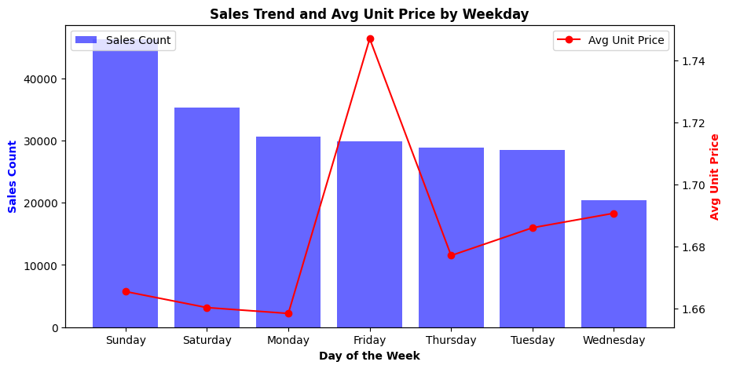
SALES TREND BY WEEKDAY
1 HIGHEST SALES : SUNDAY HAS THE HIGHEST NUMBER OF TRANSACTIONS.
2 STRONG SALES: SATURDAY, MONDAY, AND FRIDAY ALSO HAVE RELATIVELY HIGH SALES.
3 LOWER SALES : WEDNESDAY HAS THE LOWEST SALES, FOLLOWED BY TUESDAY AND THURSDAY.
4 HIGHEST AVERAGE UNIT PRICE : FRIDAY SHOWS A SIGNIFICANT SPIKE IN UNIT PRICE, WHILE SALES VOLUME IS MODERATE.

Slide 11
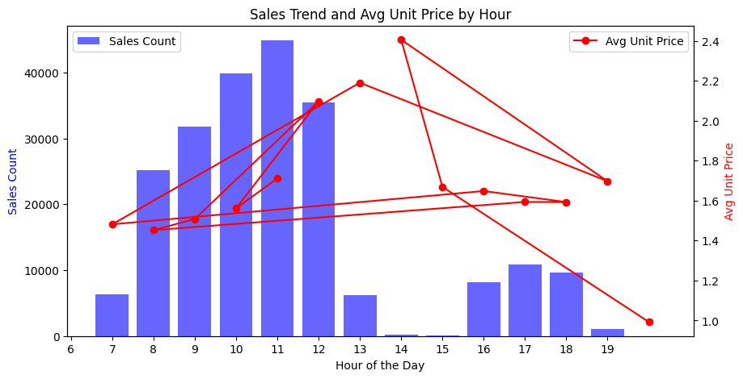
SALES TREND BY HOUR
1 HIGHEST SALES : BETWEEN 10 AM AND 12 PM, WITH THE PEAK AT 12 PM.
2 MODERATE SALES: BETWEEN 8 AM TO 9 AM AND 3 PM TO 6 PM.
.
3 LOWEST SALES : (AT 7 AM AND THEN 2 , 3 ,7 PM )
4 HIGHEST AVERAGE PRICE : AROUND 2 PM, BUT IT DOES NOT CORRELATE WITH HIGH SALES.
- STABLE PRICES: BETWEEN 8 AM AND 12 PM , WHICH ALIGNS WITH PEAK SALES.
- PRICE DROP IN LATE EVENING: THE LOWEST UNIT PRICE IS AFTER 8 PM, POTENTIALLY DUE TO DISCOUNTS OR CLEARANCE SALES.

Slide 12
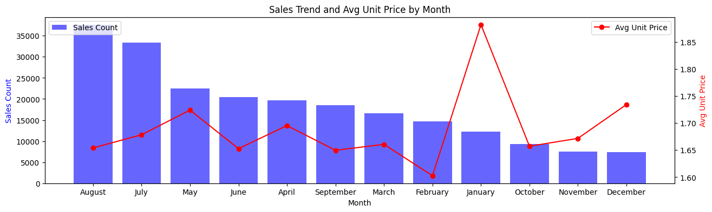
SALES TREND BY MONTH
1 HIGHEST SALES: AUGUST AND JULY HAD THE HIGHEST SALES COUNT.
2 Lowest Sales: January and February had the lowest sales.
3 Mid-Year Drop: Sales declined after July and remained lower for the rest of the year.
- PRICE SURGE IN JANUARY: A SHARP INCREASE IN AVERAGE UNIT PRICE IN JANUARY.
- Lowest Prices in February: Prices dropped significantly right after the January peak.
- Gradual Increase Toward Year-End: Prices slightly increased from October to December.

Slide 13
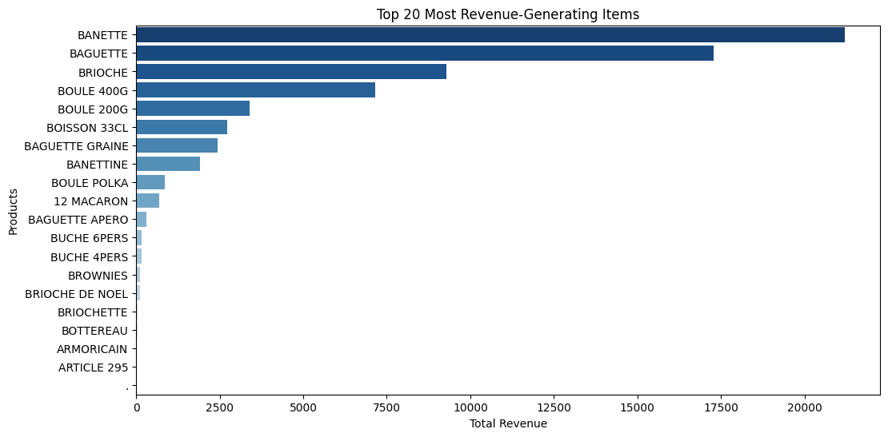
TOP 20 MOST REVENUE GENERATING ITEMS
BANETTE IS THE MOST REVENUE GENERATING PRODUCTS FOLLOWED BY OTHERS

Slide 14
INSIGHTS AND RECOMMENDATIONS
IN 2022 REVENUE IS LESS AS COMARED TO 2021 SO STARATIGIES ARE REQUIRED TO ENHANCE PERFROMACE OF BUSINESS
BUNDLE & UPSELL: INCREASE REVENUE BY BUNDLING POPULAR BAKERY STAPLES WITH HIGHER-MARGIN OR LESS POPULAR PRODUCTS (E.G., BREAD + PREMIUM SPREADS).
THERE IS NOT TOO STRONG BUT THERE IS SOME CORRELATION BETWEEN PRICE AND SALES SO PRICING ADJUSTMENT IS REQUIRED FOR THE ITEMS THAT ARE UNPOPULAR AND SELLING LESS .
WEEKEND DEMAND: HIGH SALES ON SATURDAY AND SUNDAY SUGGEST THESE ARE PEAK SHOPPING DAYS. CONSIDER PROMOTIONS OR BUNDLING DEALS TO MAXIMIZE REVENUE.
FRIDAY PRICE SURGE: THE PRICE SPIKE ON FRIDAY COULD MEAN:
PREMIUM-PRICED ITEMS ARE SOLD MORE.
PRICE HIKES BEFORE THE WEEKEND WHEN DEMAND IS EXPECTED TO INCREASE.
FEWER DISCOUNTS OR PROMOTIONAL OFFERS.
MIDWEEK SALES STRATEGY: SINCE WEDNESDAY AND THURSDAY HAVE LOWER SALES, CONSIDER INTRODUCING MIDWEEK PROMOTIONS TO BOOST REVENUE.
Pick one of our services
Routine checks for six months
Service adjustment in the sixth month

Slide 15
INSIGHTS AND RECOMMENDATIONS
OPTIMAL PRICING STRATEGY: PRICES ARE HIGH AROUND 2 PM, BUT SALES ARE LOW. CONSIDER ADJUSTING PRICING TO BOOST SALES IN THE AFTERNOON.
Promotion Opportunities: If the 10 AM - 12 PM slot is the busiest, offering bundle deals or upselling could maximize revenue.
Evening Discount Strategy: If prices drop at night, this could indicate end-of-day promotions or lower demand.
SEASONALITY : SALES PEAK IN MID-YEAR (AUGUST, JULY), POSSIBLY DUE TO SEASONAL DEMAND.
PRICE ELASTICITY : HIGHER PRICES IN JANUARY DIDN'T LEAD TO HIGHER SALES.
→ SUGGESTS DEMAND IS PRICE-SENSITIVE.
END-OF-YEAR STRATEGY: IF HIGHER PRICES WORK IN JANUARY BUT NOT IN OTHER MONTHS, CONSIDER PROMOTIONS OR PRICE ADJUSTMENTS.
DEMAND FOCUS: BANETTE AND BAGUETTE DOMINATE SALES—ENSURE CONSISTENT STOCK AND EXPLORE PREMIUM VARIANTS.
UPSELLING: BUNDLE HIGH-SELLING ITEMS WITH LOWER-PERFORMING PRODUCTS (E.G., SPREADS, COFFEE).
PRICING STRATEGY: SLIGHTLY ADJUST PRICES OR INTRODUCE PREMIUM VERSIONS TO BOOST MARGINS.
SUPPLY CHAIN: OPTIMIZE INVENTORY TO PREVENT STOCKOUTS AND ALIGN WITH DEMAND TRENDS.
LET ME KNOW IF YOU NEED REFINEMENTS!
Pick one of our services
Routine checks for six months
Service adjustment in the sixth month

Slide 16
THANK YOU
ilyasamish@gmail.com

